Slide 1
HARASSMENT TRAINING
ISS/IAT/MSS

Slide 2
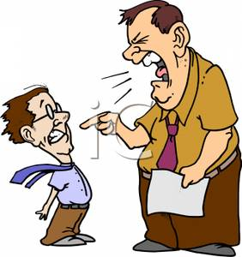
I don’t care what the customer wants!

Slide 3
AGENDA
Employees & Harassment
ISS Company Policy
Defining Harassment
Harassment & You
Preventing Harassment (before a complaint)
Following a Complaint

Slide 4
EMPLOYEES HAVE THREE TOOLS
Union Employees Have a Grievance Process
Workplace Rights Policy
Nova Scotia Human Rights Act
Notes:
Most of us are fortunate as HRM employees to have a number of tools to protect us and our rights.
Ask the group to show hands as to who in the room are unionized employees.
Unionized employees have even more protection than non unionized employees.
In the day before unions and the Human Rights Act employees had little protection from not only their employers but from their co-workers.
If the company decided to cut wages it did. If the boss pushed you around, you were expected to take it or quit.
We often do not think of HRM as a progressive employer.
However, HRM has put an extra level of protection in place. This is the Workplace Rights Policy.
A final level of protection exists. This is the Nova Scotia Human Rights Act.
There is a Canadian Human Rights Act. This is different that the Nova Scotia Human Rights Act.
It covers employees who work for the federal government and it’s agencies. It is not a level above the Nova Scotia Human Rights Act. This is a common misunderstanding.

Slide 5
NOVA SCOTIA HUMAN RIGHTS COMMISSION
It is an independent government commission established by the Government of Nova Scotia that is charged with the administration of the Province’s Human Rights Act.
Notes:
This is the body in Nova Scotia that administers those standards or expectations for dignity and respect that we spoke of a few slides ago. Those expectations or standards are established in the Nova Scotia Human Rights Act. The central office of the Commission is located in Halifax and there are regional offices in Sydney, Digby and New Glasgow. The staff of the Commission investigate and resolve complaints of discrimination. The staff also through its’ Race Relations and affirmative Action Division provide programs and services on a wide range of diversity topics, policy development and preventing or dealing with sexual harassment.

Slide 6
DISCRIMINATION IS PROHIBITED
The provision of, or access to services or facilities
Accommodation
The purchase or sale of property
Employment
Volunteer public service
A publication, broadcast or advertisement
Membership in a professional association, business or trade association, employers’ organization or employees’ organization
Notes:
The Nova Scotia Human Rights Act prohibits discrimination in any of the above situations.

Slide 7
DISCRIMINATION PROHIBITED AGAINST
Race/Colour Religion/Creed Family Status
Ethnic/National Origin Retaliation Physical Disability Association Gender Source of Income Mental Disability
Pregnancy Aboriginal Origin Age
Sexual Orientation Political Affiliation Marital Status
Irrational Fear of Contracting an Illness
Notes:
In 1969 when the Human Rights Act was revised, it began specifying in the Act those individuals or class of individuals covered under the Act. This is the original list. During subsequent revisions of the Act other individuals or classes of individuals were added.
Race/Colour 1969, Religion/Creed 1969, Ethnic/National Origin 1969, Association 1969, Retaliation 1969, Gender 1972, Physical Disability 1974,
Source of Income 1982, Mental Disability 1986, Pregnancy 1991, Age 1991, Aboriginal Origin 1991, Sexual Orientation 1991,
Sexual Harassment 1991, Political Affiliation 1991, Marital Status 1991, Family Status 1991 and Irrational Fear of Contracting an Illness 1991

Slide 8
SEXUAL HARASSMENT
Recognized as part of the Human Rights Act.
It is unwelcome conduct of a sexual nature.
Unwelcome is defined by the recipient and any third party who might observe or hear it.
Flirtatious behavior and inappropriate clothing can be considered.
Notes:
The Nova Scotia Human Rights act specifically speaks of sexual harassment. All workers have a right to a workplace that is free from sexual harassment. The term unwelcome is often used. What is unwelcome to one person may be perfectly acceptable to another. However it is up to the recipient or a third party on what is unwelcome. What the originator believes is not the issue. In most cases of sexual harassment it involves comments that are inappropriate. It can involve the inappropriate dress of an individual. The employer has the right to decide on what is or is not appropriate in terms of dress. Inappropriate workplace comments that includes patronizing comments on appearance can be considered as unwelcome conduct. Ask the participants to give some examples of unwelcome conduct. Use the flip chart and start a list with flirtatious behavior and inappropriate clothing. Add to the list. Distribute the handout “Examples of Unwelcome Conduct”. Explain this handout gives a list of many of the things that are inappropriate in conduct.

Slide 9
THE ISS POLICY
Committed to an harassment free workplace.
Committed to a workplace characterized by respect and dignity.
Recognizes harassment as a complex matter.
Recognizes the need for resolving such matters promptly.

Slide 10
ISS DEFINITION OF HARASSMENT
It is any improper conduct directed at someone, that the person finds offensive and harmful and that a reasonable person would view as unwelcome or offensive.

Slide 11
SOME POLICY EXAMPLES
Sexist or racist activities
Threats
Rude remarks
Insults
Intimidation
Retaliation
More …

Slide 12
NOT AN EASY SUBJECT
Bias
Stereotypes
Preconceptions
Hearsay
Lack of Knowledge

Slide 13
CONTINUUIM OF DISRESPECT
Disrespect
Harassment
Bullying
Violence
Notes:
Explain that discrimination is the process of making a distinction. It involves the same behaviour that includes using micro inequities. It does not necessarily mean that if you use micro inequities that next week you may become a racist. What it is saying is that if you are a bully you show a lack of respect. If you are a racist you are showing a lack of respect.
Suggest this is a great time to take a break and inform the group at what time the program will resume.

Slide 14
IT CAN GROW!
Link 1

Slide 15
DISRESPECT
The little things at work that most persons see as a nuisance and increase an employee’s frustration. Often called micro-inequities or referred to as a lack of manners.

Slide 16
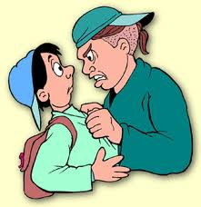
BULLYING
A pattern of aggressive behaviour meant to hurt or cause discomfort to another person. The power of a bully comes from the physical size, strength, status, or support of their peer group.

Slide 17
HARASSMENT
Improper conduct or one time incident or a series of incidents that:
Intimidates
Demeans
Threatens
Belittles a person towards whom it is intended

Slide 18
WHO MAY HARASS?
A Boss
An Employee
An Outside Contractor
A Customer

Slide 19
THIRD PARTY HARASSMENT
This occurs when a person not intended to be a part of the joke, the gossip, the name calling , swearing or any other harassing activity overhears sees or is otherwise exposed to the harassing activity.

Slide 20
TYPES OF HARASSMENT
Personal Harassment
Physical Harassment
Sexual Harassment
Poisoned Work Environment / Hostile Work Environment

Slide 21

PERSONAL HARASSMENT
Cartoons
Jokes
Yelling
Rumors
Gossip
Swearing
Name calling
Exclusion

Slide 22
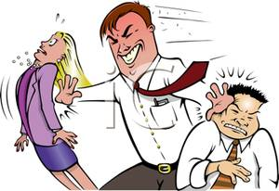
PHYSICAL HARASSMENT
Blocking the path
Pushing
Touching (non sexual)
Striking
Damaging property

Slide 23
POISONED WORK ENVIRONMENT
Defined as ongoing, pervasive and severe behaviour that:
(1) Unreasonably interferes with a person’s work performance, or
(2) Creates an intimidating, hostile or offensive work environment.

Slide 24
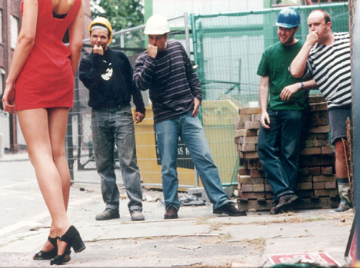
SEXUAL HARASSMENT
Whistling
Leering
Touching (sexual)
Comments on anatomy
Degrading terms
Sexual gestures
Unwanted advances
Quid Pro Quo
(This for that)

Slide 25
SOME PEOPLE DO NOT GET IT!
Link 2

Slide 26
QUID PRO QUO
Usually characterized in a supervisor employee relationship where the person in authority uses or threatens to use their power to influence the employee in a sexual or wanted sexual relationship. It threatens the with holding of advancement or other job benefits.

Slide 27
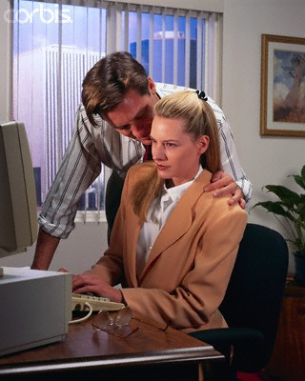
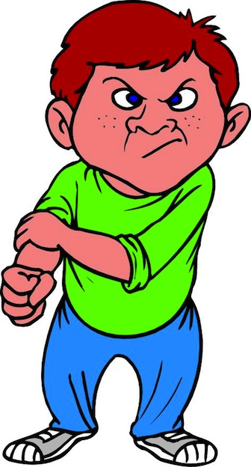
NOT ACCEPTABLE!
Just one Kiss!
My Way or Else!

Slide 28
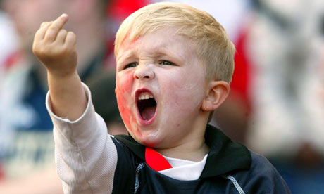
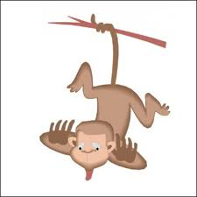
NOT ACCEPTABLE
Not your child!
Teasing Monkey

Slide 29
WHAT IS NOT HARASSMENT!
A one time bad judgement
Constructive criticism
The right to manage

Slide 30
THE RIGHT TO MANAGE
Managers and supervisors always retain the right to give direction to or correct to employees. This is an essential part of their responsibilities.
However, it is the manner of how that management responsibility is conducted that is important.

Slide 31
QUESTIONS?

Slide 32

HARASSMENT & YOU
What do I do?
Why I feel the way I do?
Protecting myself!

Slide 33
IF YOU HAVE BEEN HARASSED?
Tell the harasser
Tell your boss
If it is your boss, tell their boss
Always seek assistance
Put complaints in writing
Notes:
It is important to remember if you are harassed and you do nothing about it, it is likely to continue. Some organizations are big enough to have a director of human resources or a human resources section that you can contact in getting assistance.

Slide 34

TELLING THE HARASSER
Verbalize your concerns to the harasser:
That you have positive intent
What specific behavior is offensive
How you were impacted
That you expect them to stop!
Notes:
This was also seen in the video presentation.

Slide 35
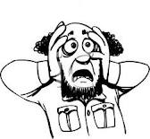
VICTIM”S FEARS
Not being believed
Being wrong
Retaliation
Gossip
Losing Control
Rejection by co-workers or boss
Becoming labeled (over sensitive, trouble maker, not having a sense of humor)
Notes:
This was also seen in the video presentation.

Slide 36
PERSONAL PROTECTION TIPS
Use a memory book
Keep emails
Keep written notes
Remember the golden rule
Limit unnecessary physical contact

Slide 37
PREVENTING HARASSMENT

Slide 38
IF YOU ARE ACCUSED
Apologize immediately
Stop whatever you were doing
Do not do it again
Keep written notes for yourself
Tell your boss about the situation and what you did to resolve it

Slide 39
WHY PREVENT HARASSMENT
Liability
Customer Lose
Lowers Costs
Employee Retention
Establishes a good work environment
Link 3

Slide 40
PREVENTING HARASSMENT (Senior Management)
Have an harassment policy
Ensure each employee has read the policy
Post the policy where it can be seen
Speak positively about a work environment free from harassment

Slide 41
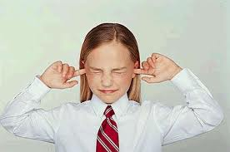
PREVENTING HARASSMENT (Managers & Supervisors)
Be a role model and good example
Don’t delay or ignore complaints
Act when you see offensive behaviour
Do not be a silent observer
Examine the workplace for offensive materials

Slide 42
QUESTIONS?

Slide 43
FOLLOWING A COMPLAINT

Slide 44
FIRST STEPS
Promptly respond to complaints
Do not guarantee confidentiality
Never make an immediate decision
Ensure you have the names of any witnesses
Ask for the complaint in writing
Caution on retaliation
Take notes (facts)

Slide 45
NEXT STEPS
Speak with respondent
Take notes
Get the names of witnesses
Do not guarantee confidentiality
Caution on retaliation

Slide 46
RESOLUTION
Meet with both parties to try and resolve
Failing initial resolution move on to investigation
Interview witnesses for facts on this case
Collect evidence such as emails, notes, pictures
Use judgement as to likely that situation did occur

Slide 47
JUDGING CREDIBILITY
Does the story make sense?
Is there evidence?
Be Aware of “hear say”!
Are the witnesses friends?
Is there a history of resentment?
Is there a motivation to lie?
Is the witness, the alleged harasser or the complainant a truthful person?
Does the harasser claim not to remember, and will not deny or confirm the event?
Notes:
Credibility is an important part of collecting information, reviewing information and investigating information in terms of harassment complaints. Here are a few key points to ask yourself.

Slide 48

THE FINDING
Harassment did take place
Harassment did not take place
Insufficient evidence to make a finding
Both parties advised of the finding
Ensure your notes indicate the nature of the finding

Slide 49
DISCIPLINE
Advise both parties the details of any discipline to take place
Witnesses and other workers are not told the finding or the nature of any discipline

Slide 50
QUESTIONS?

Slide 51
CASE STUDY John & Susan

Slide 52
FINDING (John & Susan)
There were no witnesses to the home visits.
Both parties admitted they did meet.
Susan produces a tape of the music played that night by John recorded as they met and with some dialogue picked up by the microphone used.
Both parties testified that he had made dinner for them; he had the fireplace on; the lights turned down; and served her wine.
Harassment did occur.
She was awarded damages and lost wages.

Slide 53
CASE STUDY Off Duty

Slide 54
FINDINGS – Off Duty
All three parties indicated the situation did take place.
It was recognized that such driving methods were unsafe and posed a potential risk.
The actions of Harry were unwelcome and not reasonable actions to be taken.
Despite being off company property the actions involved an employer / employee relationship.

